Slide 1
Week 14-Lec 2
DNS

Slide 2
DNS: domain name system
people: many identifiers:
SSN, name, passport #
Internet hosts, routers:
IP address (32 bit) - used for addressing datagrams
“name”, e.g., www.yahoo.com - used by humans
Q: how to map between IP address and name, and vice versa ?
Domain Name System:
distributed database implemented in hierarchy of many name servers
application-layer protocol: hosts, name servers communicate to resolve names (address/name translation)
note: core Internet function, implemented as application-layer protocol
complexity at network’s “edge”

Slide 3
DNS: services, structure
DNS services
hostname to IP address translation
host aliasing
canonical, alias names
mail server aliasing
load distribution
replicated Web servers: many IP addresses correspond to one name
why not centralize DNS?
single point of failure
traffic volume
distant centralized database
maintenance
A: doesn‘t scale!

Slide 4
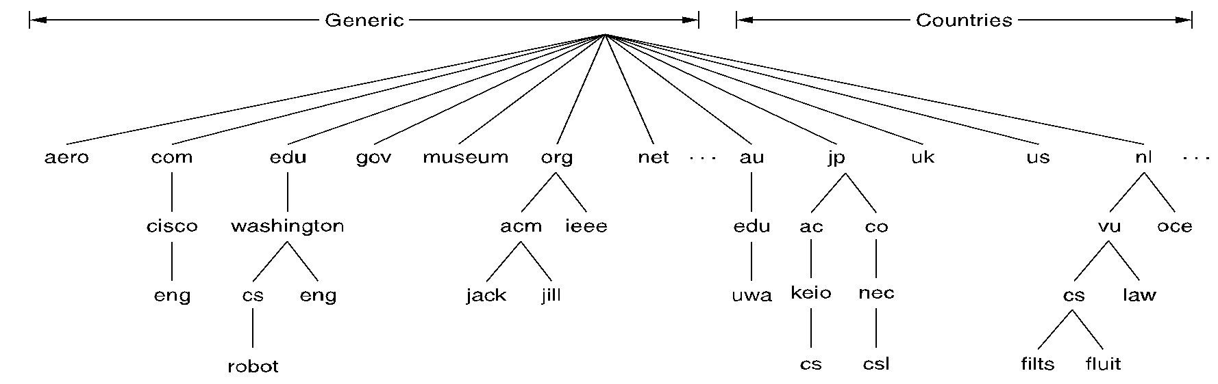
DNS: a distributed, hierarchical database
Root DNS Servers
in DNS servers
com DNS servers
org DNS servers
edu DNS servers
poly.edu
DNS servers
umass.edu
DNS servers
ac.in
DNS servers
yahoo.com
DNS servers
amazon.com
DNS servers
Incovid.org
DNS servers

Slide 5
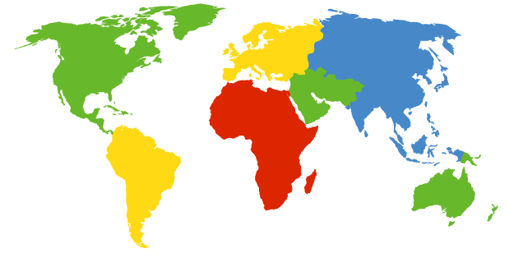
DNS: root name servers
contacted by local name server that can not resolve name
root name server:
contacts authoritative name server if name mapping not known
gets mapping
returns mapping to local name server
c. Cogent, Herndon, VA (5 other sites)
d. U Maryland College Park, MD
h. ARL Aberdeen, MD
j. Verisign, Dulles VA (69 other sites )
k. RIPE London (17 other sites)
i. Netnod, Stockholm (37 other sites)
e. NASA Mt View, CA
f. Internet Software C.
Palo Alto, CA (and 48 other sites)
m. WIDE Tokyo
(5 other sites)
13 logical root name “servers” worldwide
each “server” replicated many times
a. Verisign, Los Angeles CA
(5 other sites)
b. USC-ISI Marina del Rey, CA
l. ICANN Los Angeles, CA
(41 other sites)
g. US DoD Columbus, OH (5 other sites)

Slide 6
TLD, authoritative servers
top-level domain (TLD) servers:
responsible for com, org, net, edu, aero, jobs, museums, and all top-level country domains, e.g.: uk, fr, ca, jp
Network Solutions maintains servers for .com TLD
Educause for .edu TLD
authoritative DNS servers:
organization’s own DNS server(s), providing authoritative hostname to IP mappings for organization’s named hosts
can be maintained by organization or service provider

Slide 7
Local DNS name server
does not strictly belong to hierarchy
each ISP (residential ISP, company, university) has one
also called “default name server”
when host makes DNS query, query is sent to its local DNS server
has local cache of recent name-to-address translation pairs (but may be out of date!)
acts as proxy, forwards query into hierarchy

Slide 8

DNS name resolution example
root DNS server
2
host at cs.daiict.ac.in wants IP address for cs.iitgn.ac.in
3
TLD DNS server
4
5
iterated query:
contacted server replies with name of server to contact
“I don’t know this name, but ask this server”
local DNS server
dns.daiict.ac.in
7
6
1
8
authoritative DNS server
dns.cs.iitgn.ac.in
requesting host
cs.daiict.ac.in
cs.iitgn.ac.in

Slide 9
DNS name resolution example
root DNS server
2
3
recursive query:
puts burden of name resolution on contacted name server
heavy load at upper levels of hierarchy?
7
6
TLD DNS
server
local DNS server
dns.daiict.ac.in
5
4
1
8
authoritative DNS server
dns.cs.iitgn.ac.in
requesting host
cs.daiict.ac.in
cs.iitgn.ac.in

Slide 10
DNS: caching, updating records
once (any) name server learns mapping, it caches mapping
cache entries timeout (disappear) after some time (TTL)
TLD servers typically cached in local name servers
thus root name servers not often visited
cached entries may be out-of-date (best effort name-to-address translation!)
if name host changes IP address, may not be known Internet-wide until all TTLs expire
update/notify mechanisms proposed IETF standard
RFC 2136

Slide 11
DNS records
DNS: distributed database storing resource records (RR)
RR format: (name, value, type, ttl)
type=A
name is hostname
value is IP address
type=CNAME
name is alias name for some “canonical” (the real) name
www.ibm.com is really
servereast.backup2.ibm.com
value is canonical name
type=NS
name is domain (e.g., foo.com)
value is hostname of authoritative name server for this domain
type=MX
value is name of mailserver associated with name

Slide 12
The complete name of a host, also known as the fully qualified domain name(FQDN), is a series of labels separated by dots or periods. Each label represents an increasingly higher domain level within a network. The complete name of a host connected to one of the larger networks generally has more than one subdomain, as shown in the following examples:
host1.subdomain2a.subdomain2.rootdomain
https://www.youtube.com/watch?v=HnUDtycXSNE

